Slide 1
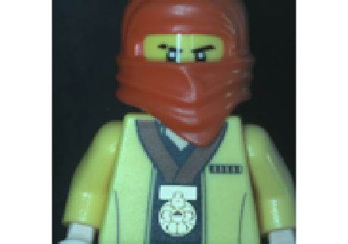
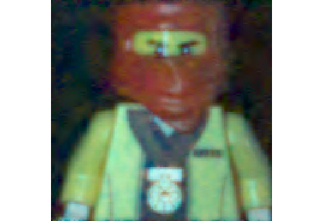
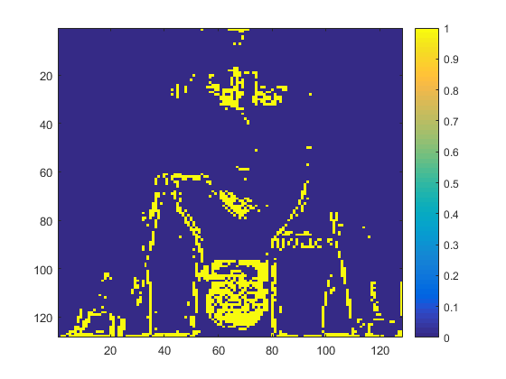
Original RGB profile
Reconstruction RGB profile
Reconstruction Error

Slide 2
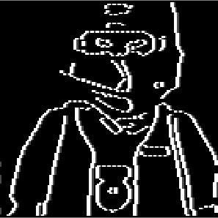
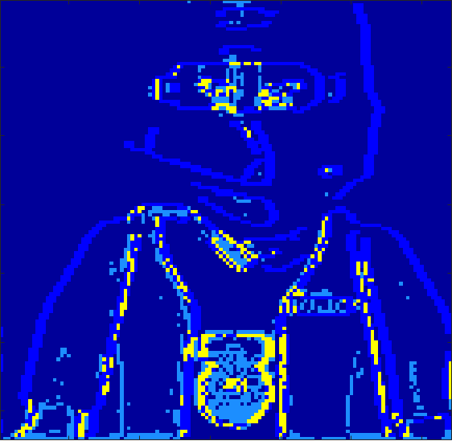
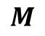
Original RGB profile
Reconstruction RGB profile
Reconstruction Error
Gradient Image
Errors in Gradient Image
$$M$$

Slide 3
Original RGB profile
Reconstruction RGB profile
Reconstruction Error

Slide 4
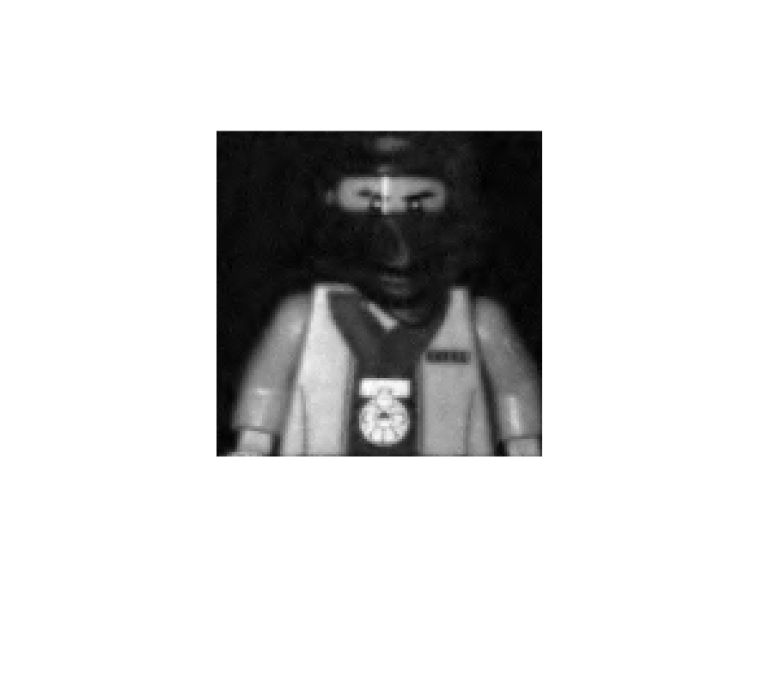
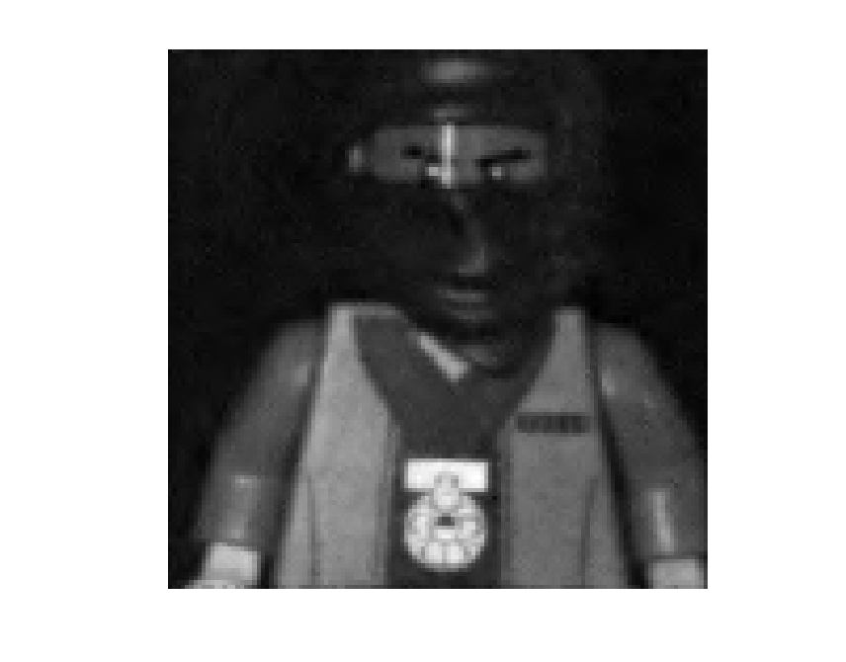
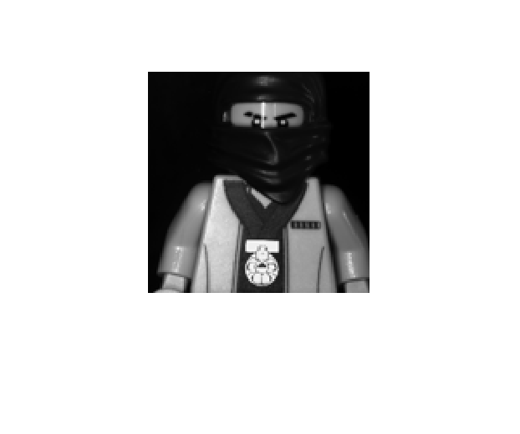
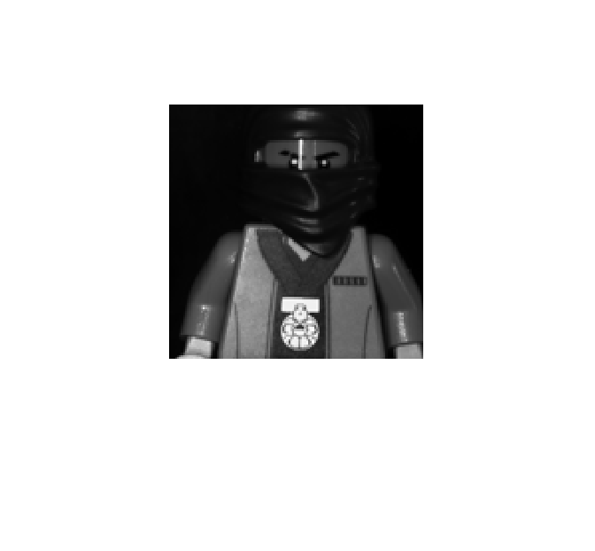
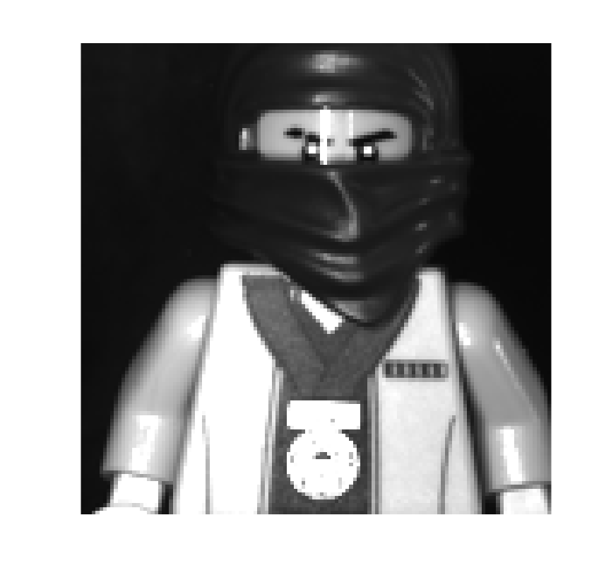
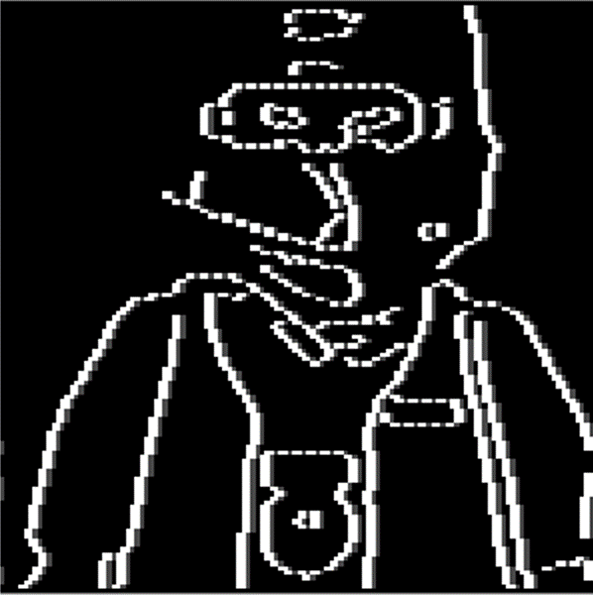
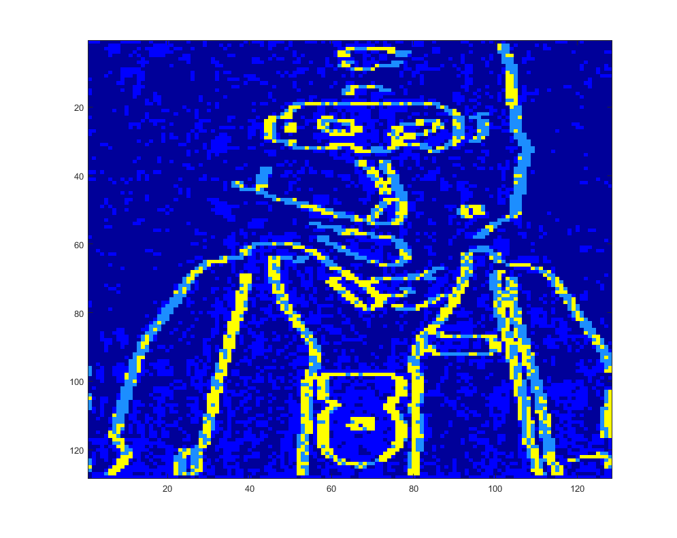
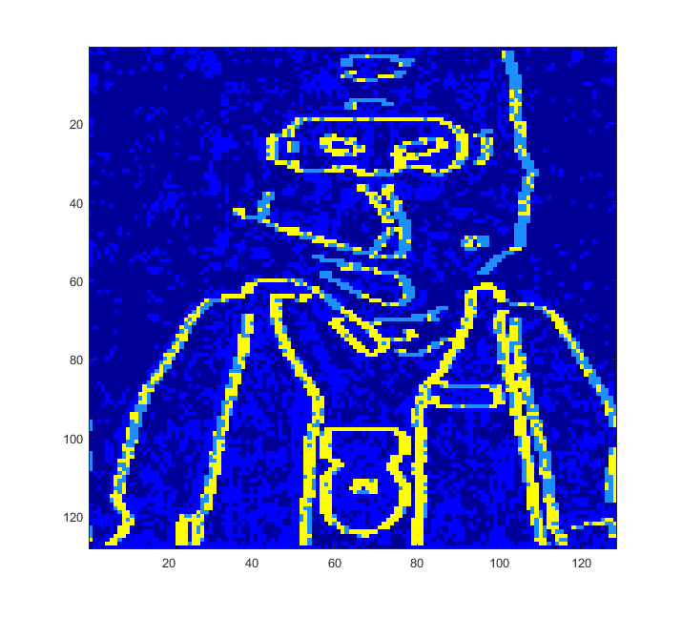
484 nm
503 nm
PSNR= 30.67
PSNR= 29.42

Slide 5
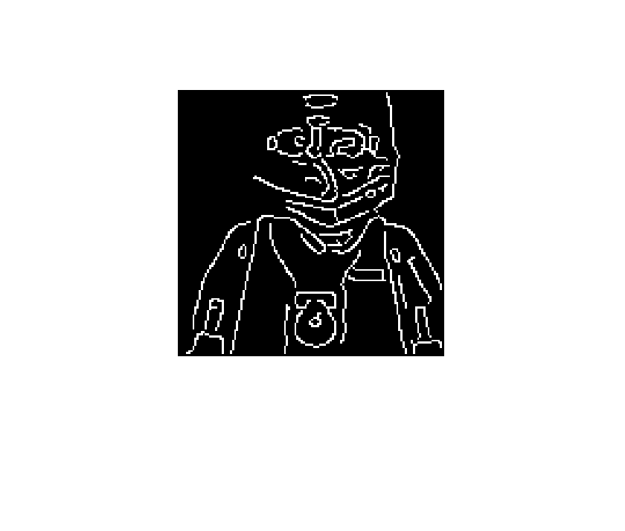
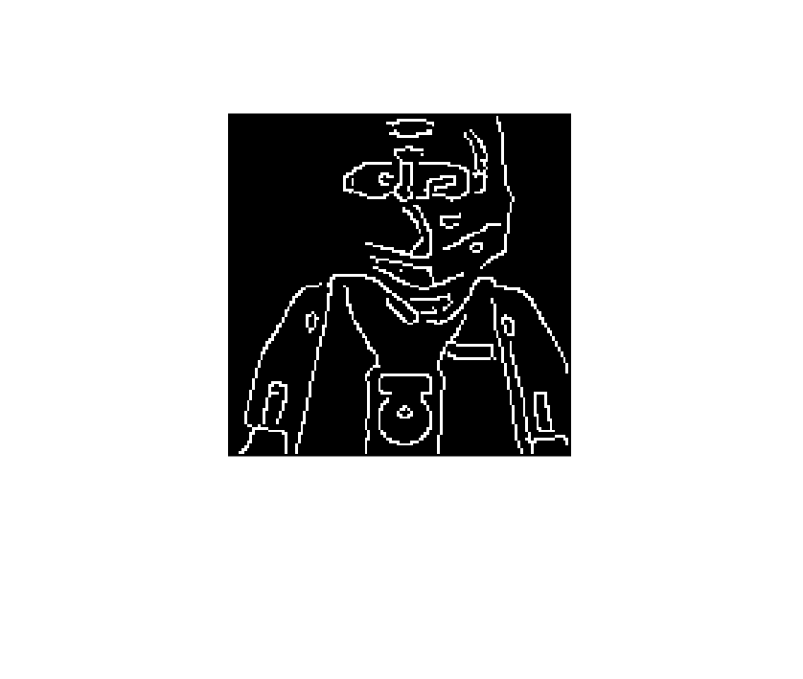
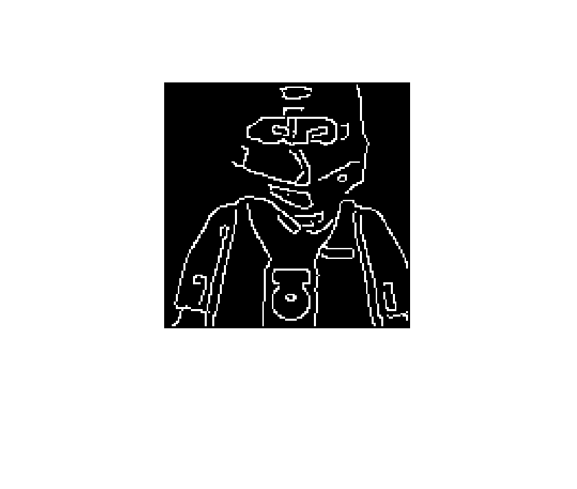
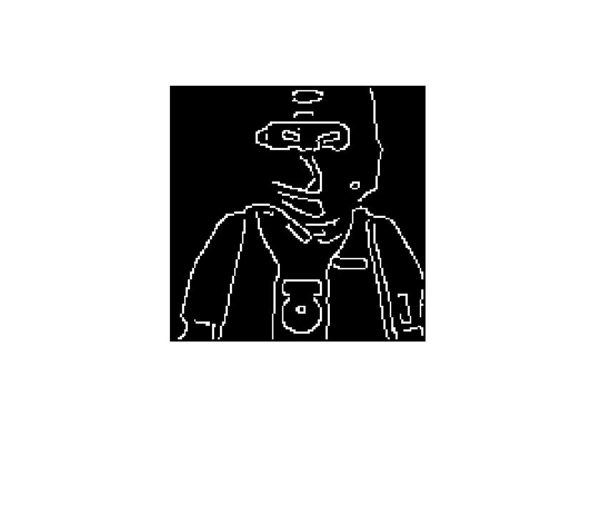
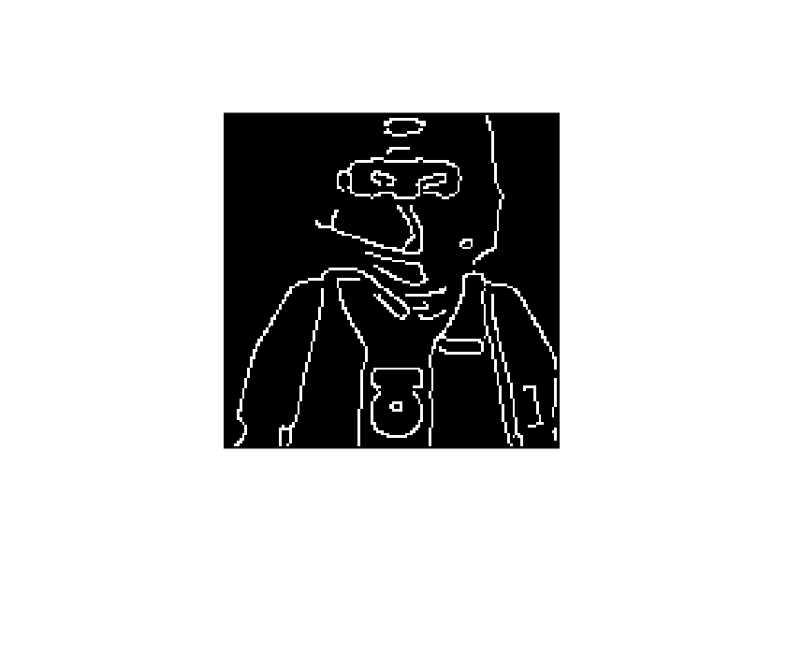
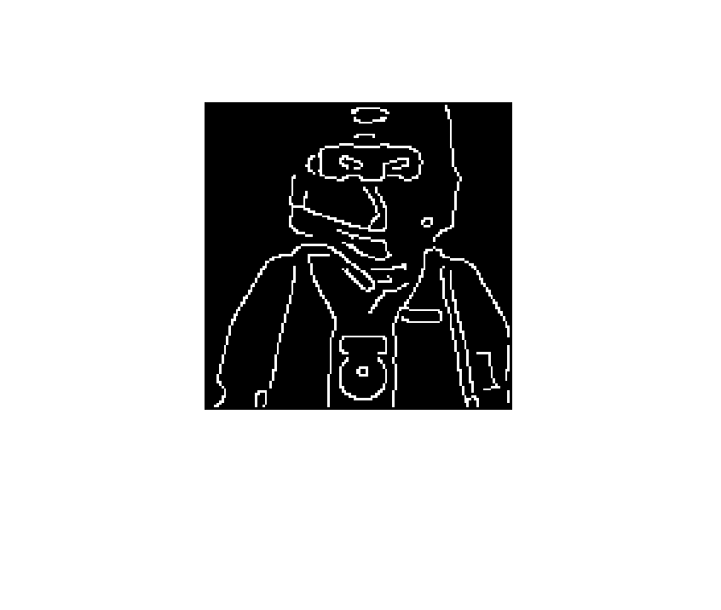
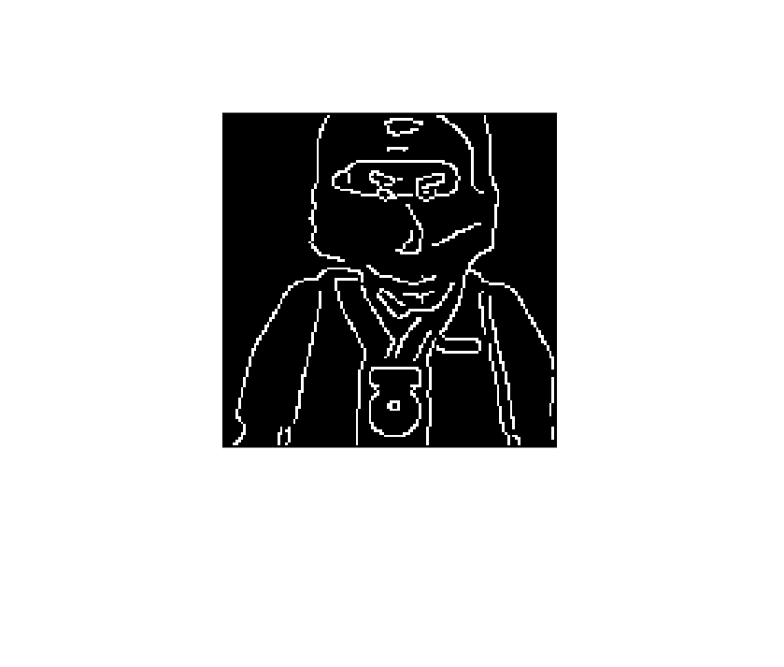
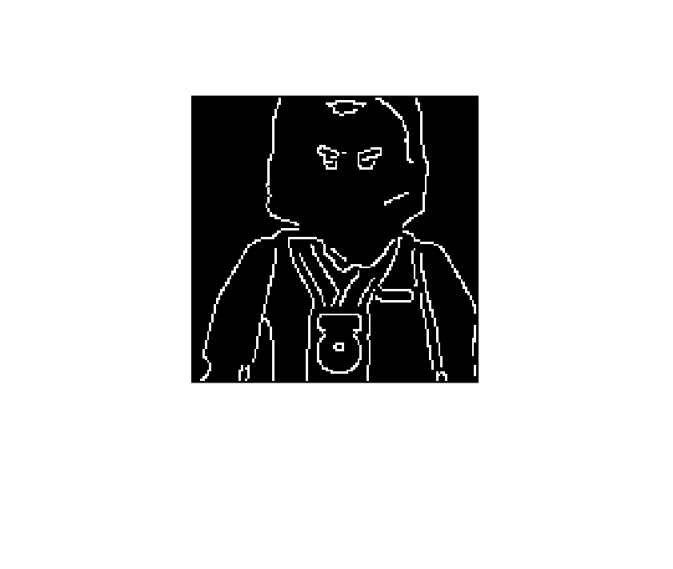
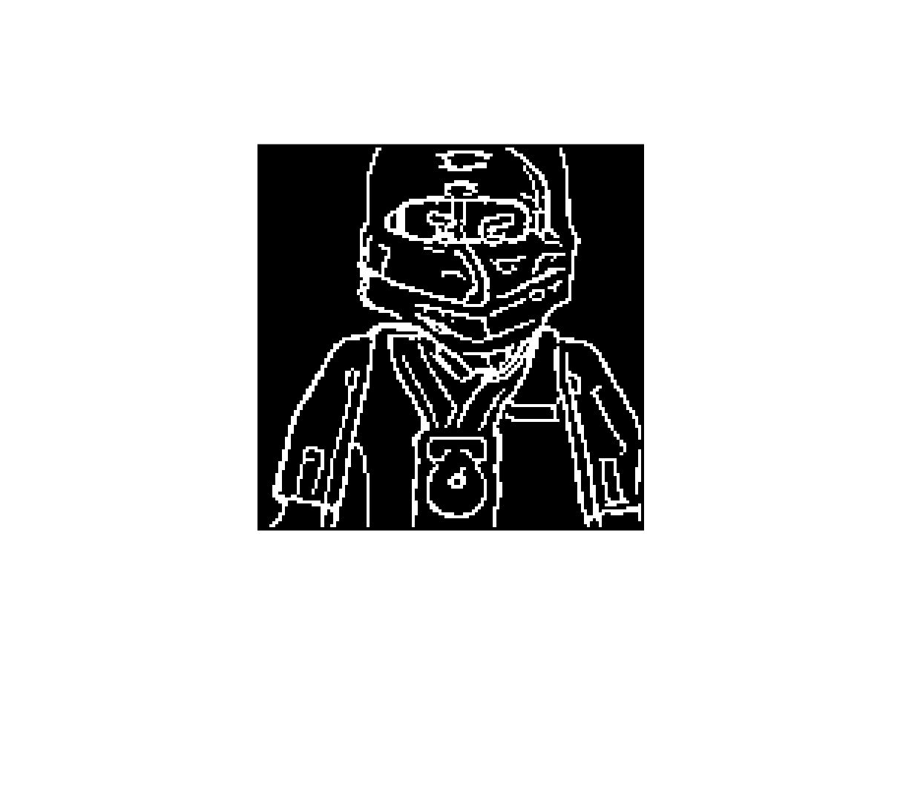
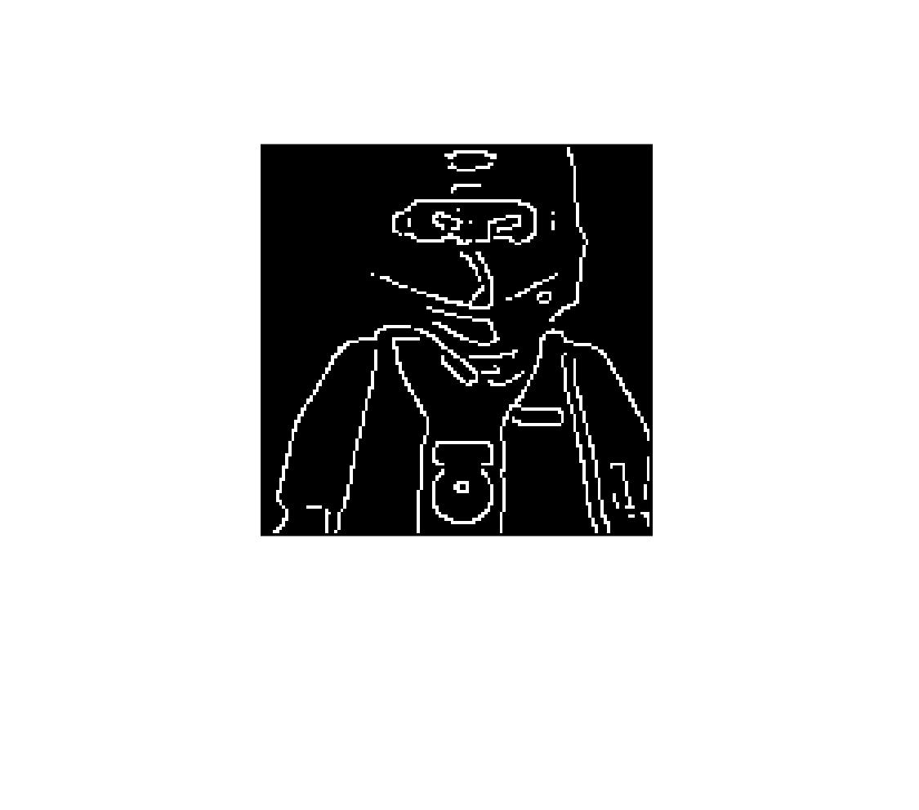
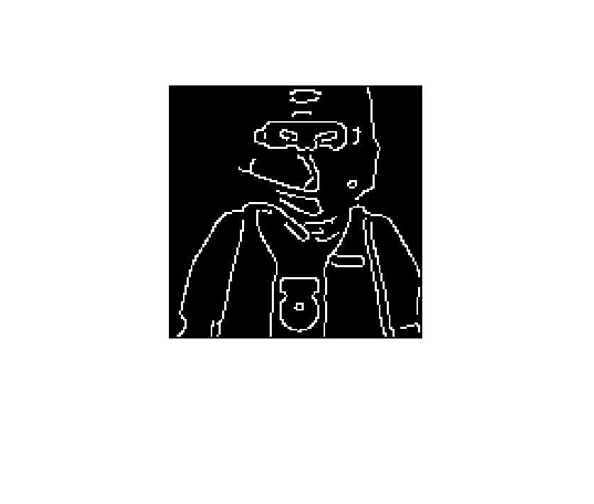
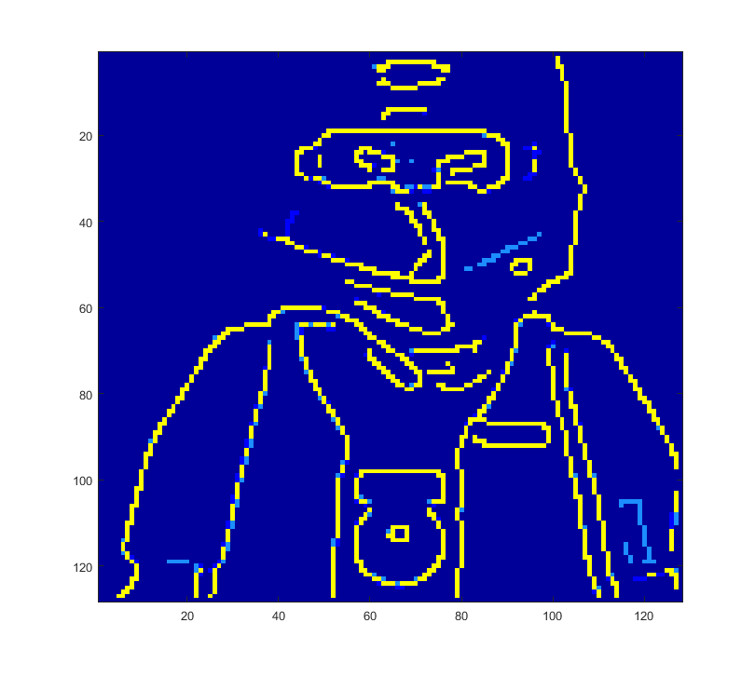
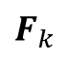
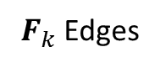
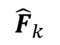
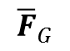
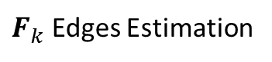
$$F_{k}$$
Grayscale Image
$${\hat{F}}_{k}$$
$${\overline{F}}_{G}$$
$F_{k}$ Edges
$F_{k}$ Edges Estimation

Slide 6
$$F_{k}$$
RGB Image
$${\hat{F}}_{k}$$
$${\overline{F}}_{G}$$
$F_{k}$ Edges
$F_{k}$ Edges Estimation

Slide 7
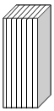
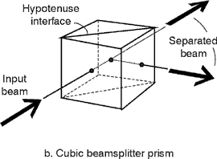
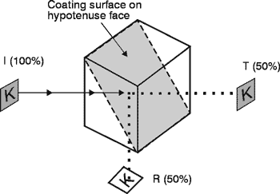
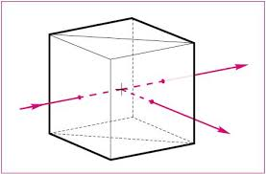
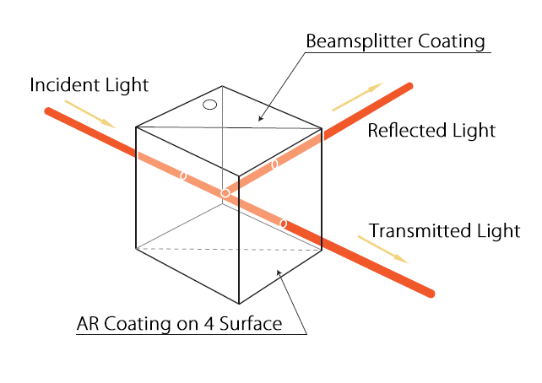
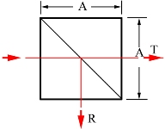
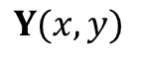
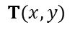
Low-resolution FPA
Imaging
lens
Dispersive element
Imaging
lens
Aperture Code
$$T(x,y)$$
Beams plitter Coating
Imaging
lens
Object, data cube
$$Y(x,y)$$
Imaging
lens
RGB
Detector
F
F
F

Slide 8
Low-resolution FPA
Imaging
lens
Dispersive element
Imaging
lens
Aperture Code
$$T(x,y)$$
Beam splitter Coating
Imaging
lens
Object, data cube
$$Y(x,y)$$
Imaging
lens
RGB
Detector
F
F
F

Slide 9
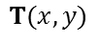
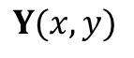
Low-resolution FPA
Imaging
lens
Dispersive element
Imaging
lens
Aperture Code
$$T(x,y)$$
Beam splitter Coating
Imaging
lens
Object, data cube
$$Y(x,y)$$
Sensing
Reconstruction Algorithm
Imaging
lens
Reconstruction
RGB
Detector
RGB Shot
F
F
F

Slide 10
Low-resolution FPA
Imaging
lens
Dispersive element
Imaging
lens
Aperture Code
$$T(x,y)$$
Beam splitter Coating
Imaging
lens
Object, data cube
$$Y(x,y)$$
Reconstruction Algorithm
Imaging
lens
Reconstruction
RGB
Detector
RGB Shot
F
F
F

Slide 11
Random

Slide 12
High

Slide 13
Low

Slide 14
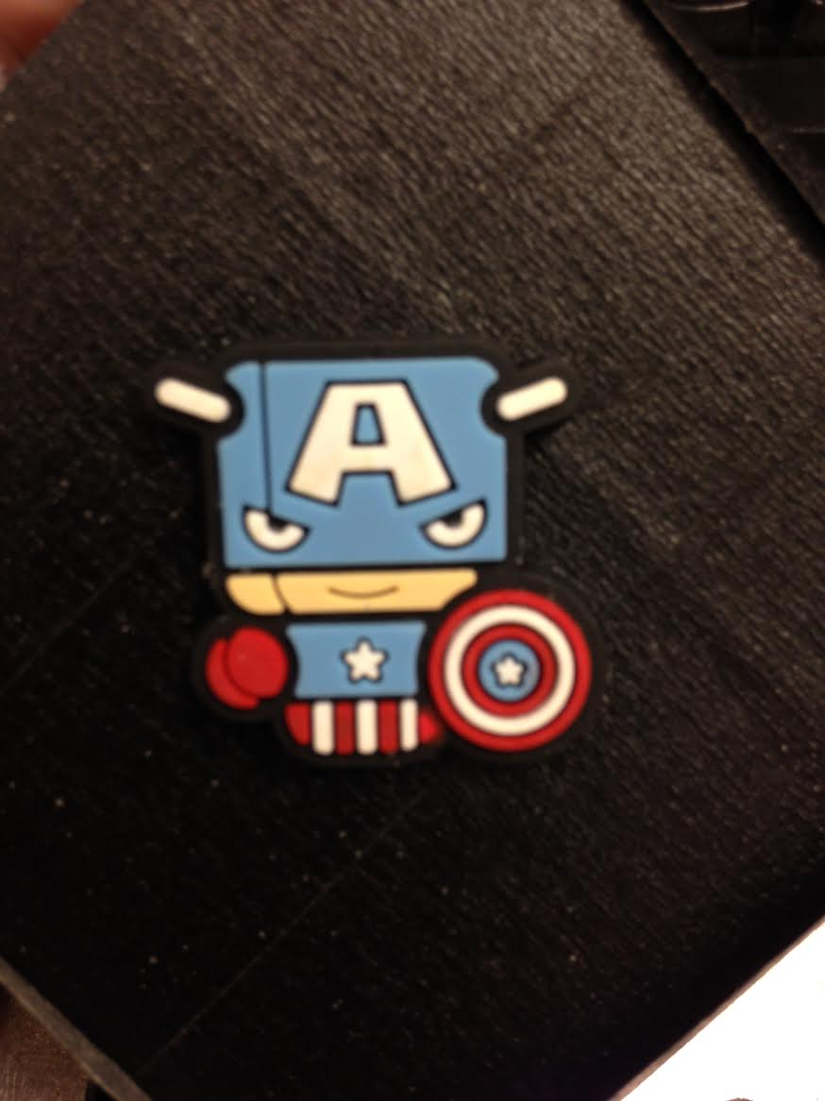
Random CA
High Transm. designed CA
Low Transm. designed CA

Slide 15
Random 0.23 SNR 8

Slide 16
Designed 0.23

Slide 17
Random 0.5 SNR 8

Slide 18
Random 0.25 SNR 8

Slide 19
1. Random 0.5 SNR 8

Slide 20
2. Random 0.5 SNR 8

Slide 21
Designed 0.23 SNR 8

Slide 22
Random T=0.25
Designed T=0.23
Random T=0.5

Slide 23
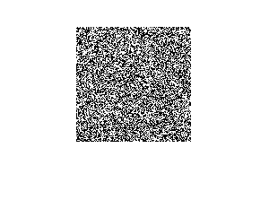
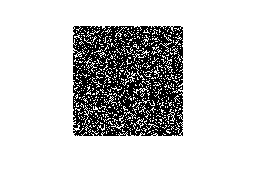
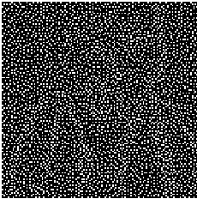
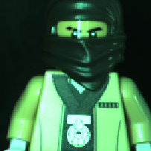
Random T=0.5
Random T=0.25
Designed T=0.23

Slide 24

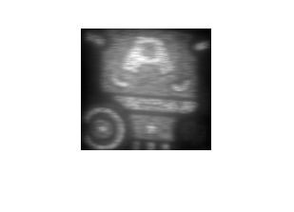
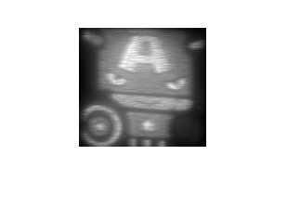
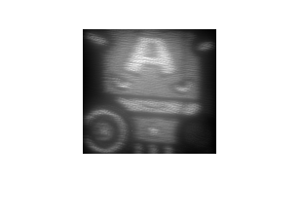
RGB SHOT
Random T=0.5
Designed Low T=0.23
Designed Low T=0.25

Slide 25
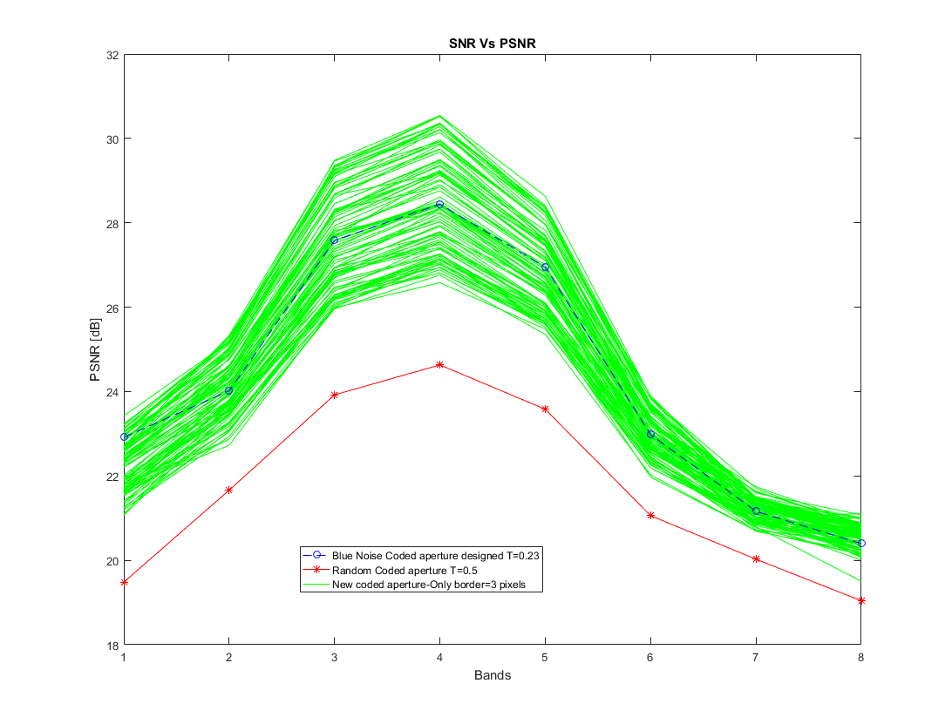

High Transmittance in borders
Low Transmittance in borders

Slide 26




Low transmittance in borders
High transmittance in borders

Slide 27


$$Y$$

Slide 28


Random T=0.5 SNR=8
Designed T=0.23 SNR=8
Average spectral reconstruction: 16.99
Average spectral reconstruction: 19.51

